Slide 1
What is Science?
Branches of Science

Slide 2
What is Science?
An organised way of gathering and analysing evidence about the natural world.
An experiment is a scientific procedure to make a discovery, test a hypothesis, or demonstrate a known fact

Slide 3
Branches of Science
Each branch of Science specialises in a different field.
Biology
Physics
Chemistry
Geology
Astronomy
Ecology
Psychology

Slide 4
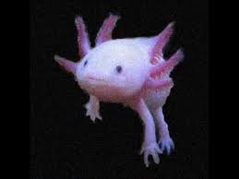

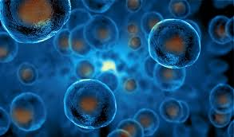
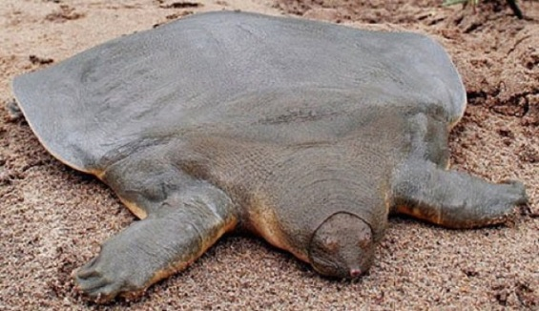
Biology
A study of living things

Slide 5
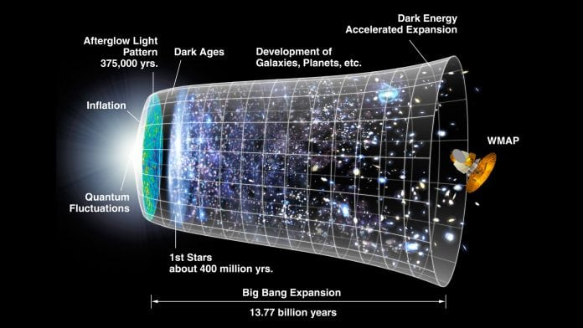

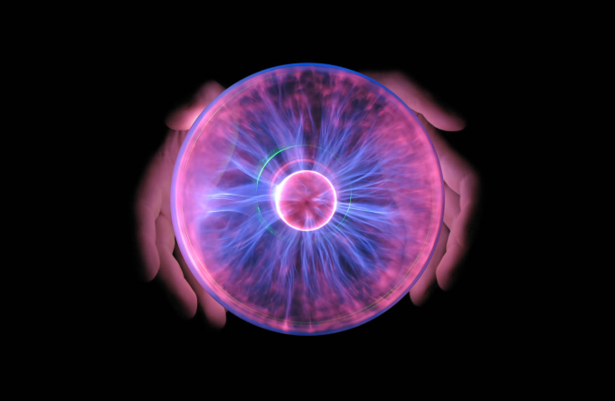

Physics
The study of matter and energy and how they interact

Slide 6
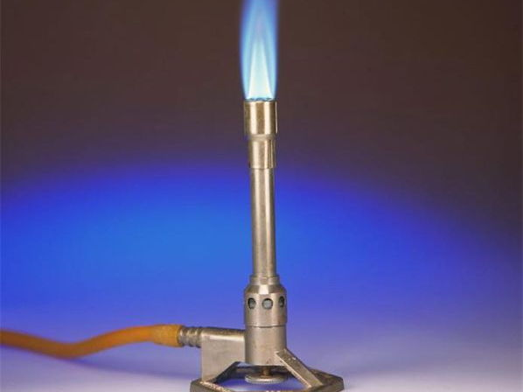

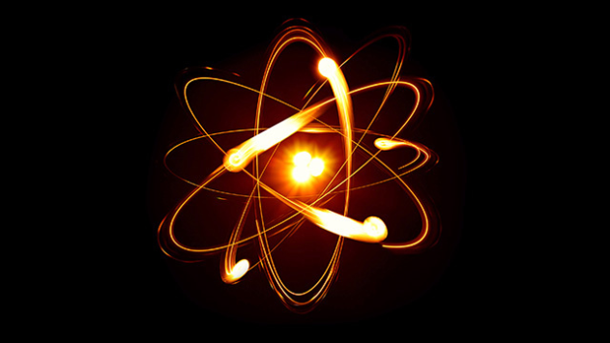
Chemistry
The study of the properties of matter and how matter changes

Slide 7
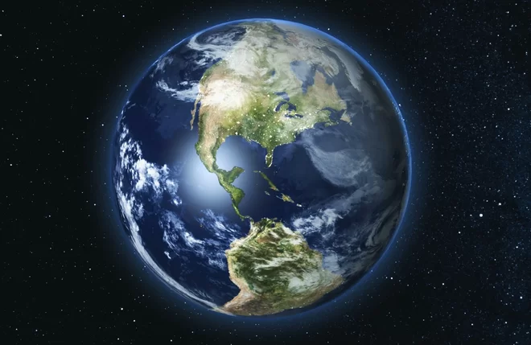


Geology
The study of the origin, history and structure of Earth

Slide 8
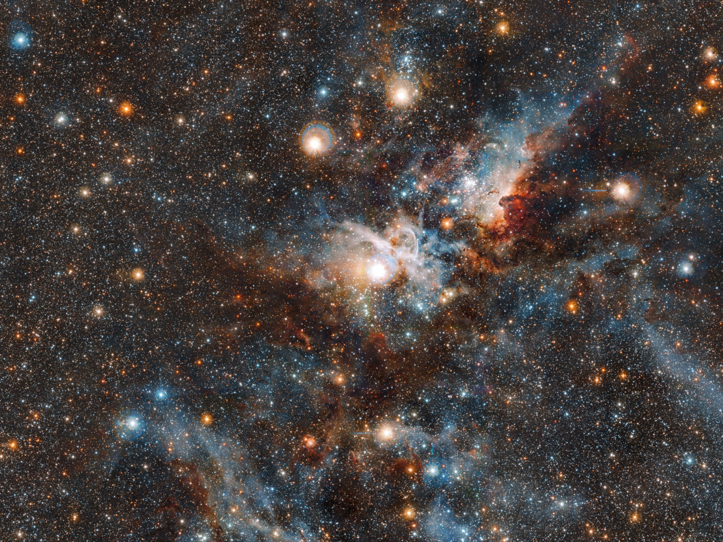
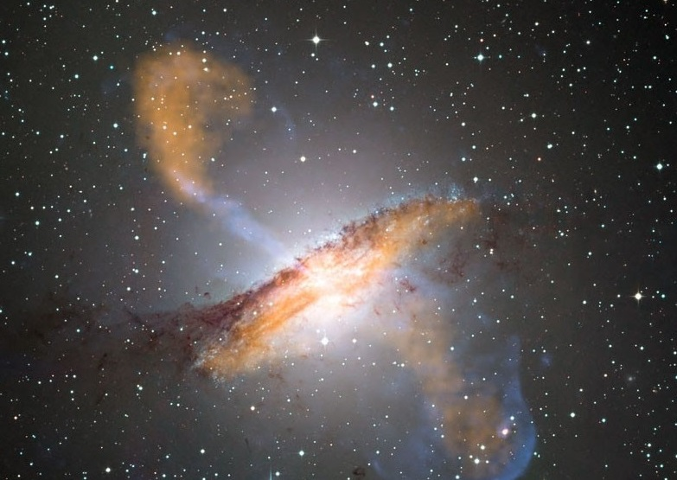
Astronomy
The study of the moon, stars, and other objects in space

Slide 9
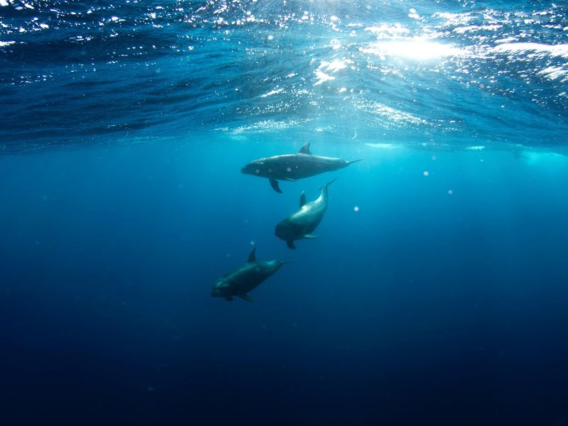
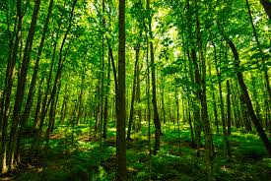

Ecology
The study of how living things interact with each other and the environment.

Slide 10

Psychology
The scientific study of behaviour and mental processes

